Slide 1
Introduction
The holy yatra to the cave of Amarnath at 13000 ft above sea level in a natural cave in Kashmir- the place where the Lord revealed the secret of immortality to Maa Parvathi
A Linga is formed out of ice naturally on an Ice peetha ( base ) in the month of Sraavan
The total trek is 30-35km with a maximum altitude of 14,500ft at a place called Magunas Pass

Slide 2
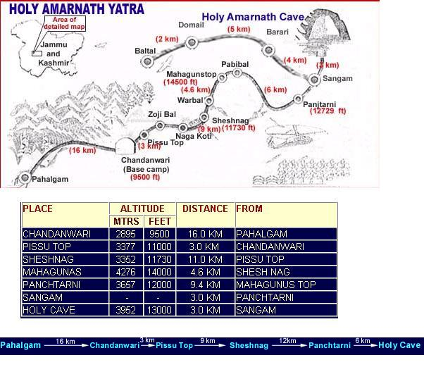
Route Map

Slide 3
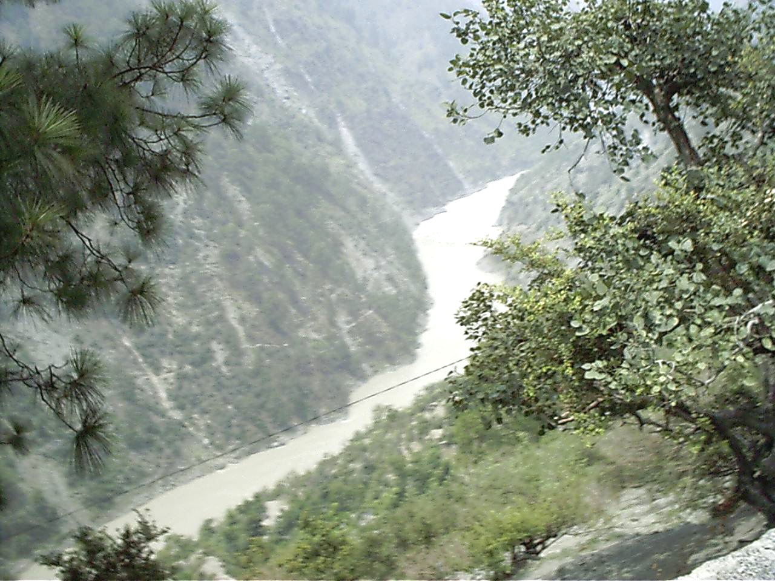
The first sight of the valley

Slide 4
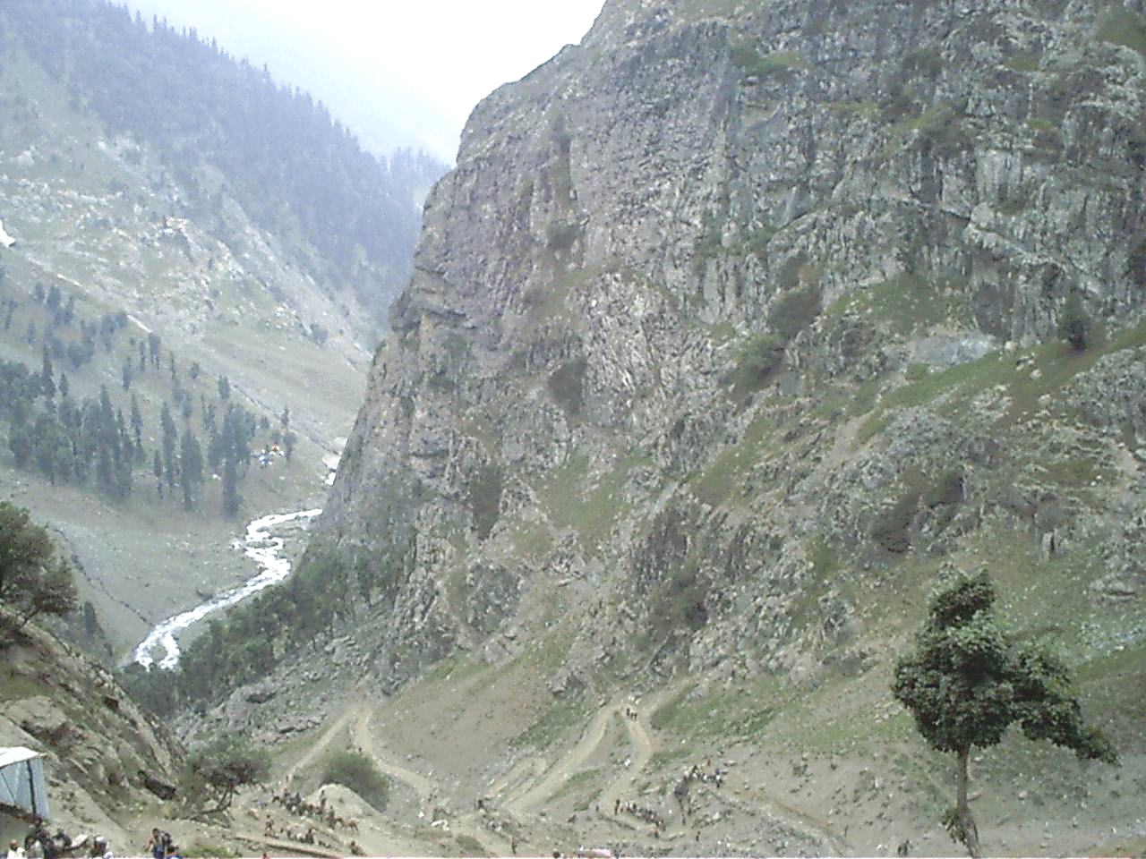
Pissu Top
Check out the gradient….almost 90 degrees..a formidable climb
Gradient -- 9000ft to 11,100ft in 3km
my speed was measurabe ------ 1 foot per second

Slide 5
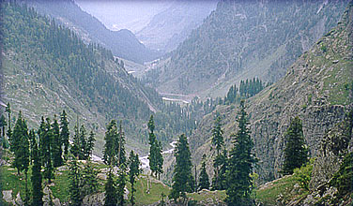
Chandanwadi as seen from Pissu

Slide 6
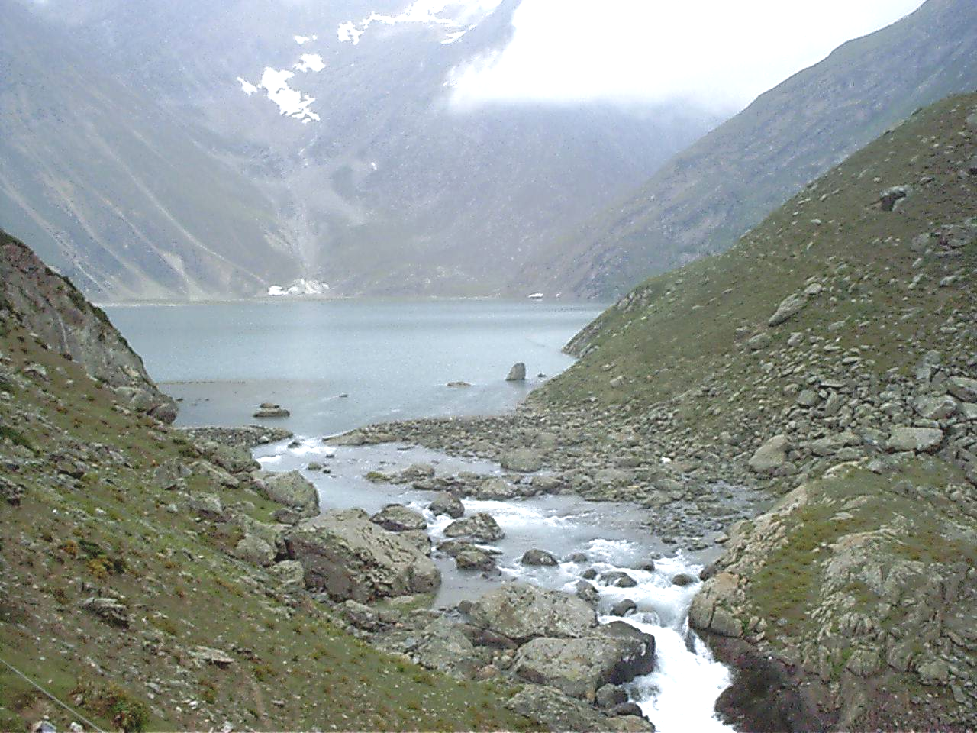
Lake Shesh Nag
2km by 0.5km

Slide 7
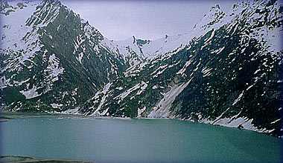
Another view of the lake with ice clad mountains

Slide 8
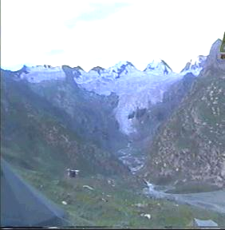
Origin of Shesh Nag

Slide 9
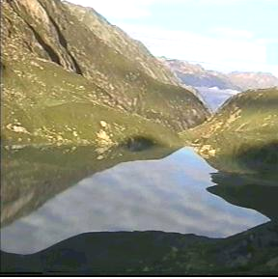
Last View of Shesh Nag

Slide 10
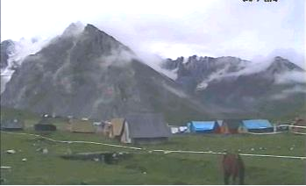
PanchTarini

Slide 11
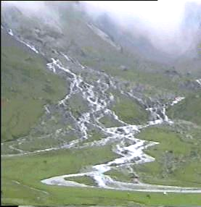
…the five streams

Slide 12
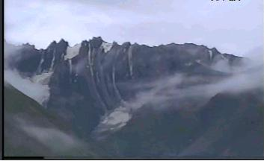
Behind Panchatarini

Slide 13
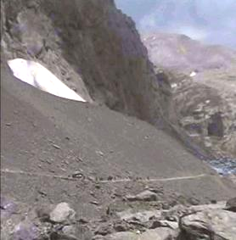
Cave from a distance

Slide 14
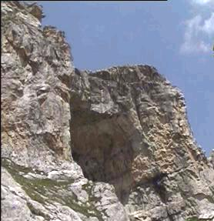
Cave again..

Slide 15
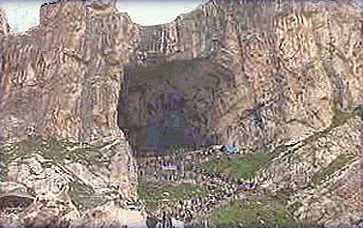
The Holy cave
Dimension : 120 ft x 80ft x 80ft

Slide 16
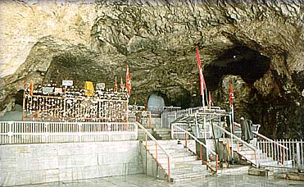
Inside the cave

Slide 17
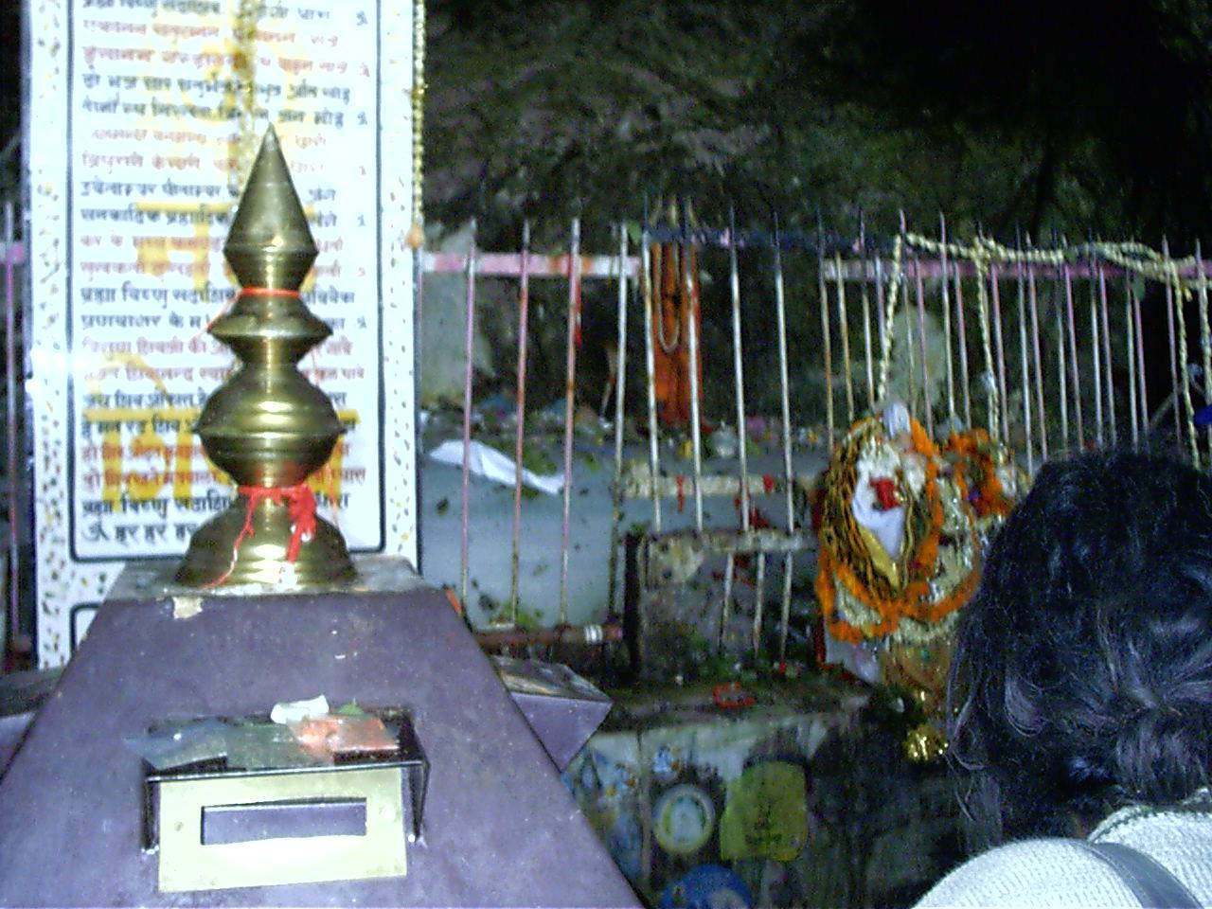
The Ice Peetha

Slide 18
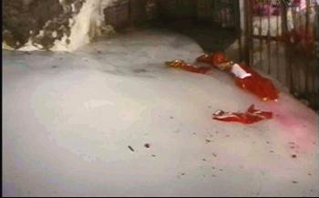
A close up of the peetha

Slide 19
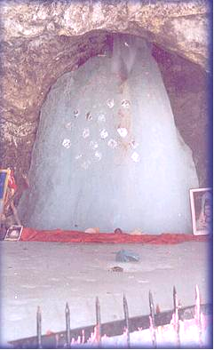
Darshan as on 06.06.2002

Slide 20
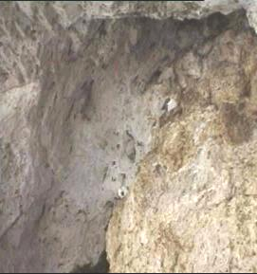
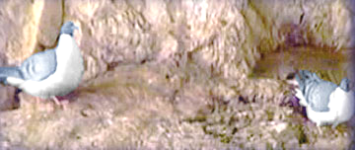
Pegions
Though no vegetation and though the climate is so hostile with ice water dripping
from all the crevices of the cave, these couple stay here always !!
Believed to be sages who overheard the conversation of the divine couple

